Slide 1
IMPROVING CUSTOMER SERVICE AND RETENTION RATES
MANDLA SENZANJE DR.RAJEEV BUKRALIA
MINNESOTA STATE UNIVERSITY, MANKATO

Slide 2

PROJECT CONTENT
WHY I DID THIS PROJECT
BASED OF A TELCO DATASET FROM THE IBM COMMUNITY WEBSITE
UNDERSTAND HOW DIFFERENT VARIABLES ARE RELATED TO SUBSCRIPTION STATUS
FEATURE IMPORTANCE
MODEL/ALGORITHM SELECTION
PREDICTION
FINDINGS/BUSINESS RECOMMENDATIONS

Slide 3
DATA
TELCO DATASET FROM THE IBM COMMUNITY WEBSITE
7044 OBSERVATIONS
21 VARIABLES
CHURN (CUSTOMER SUBSCRIPTION OUTCOME) IS THE TARGET VARIABLE

Slide 4
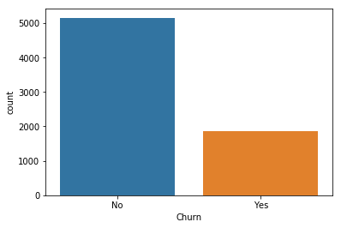
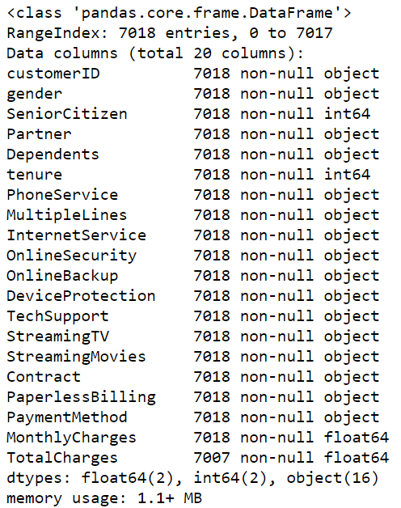
EXPLORATORY DATA ANALYSIS
5157
1861

Slide 5
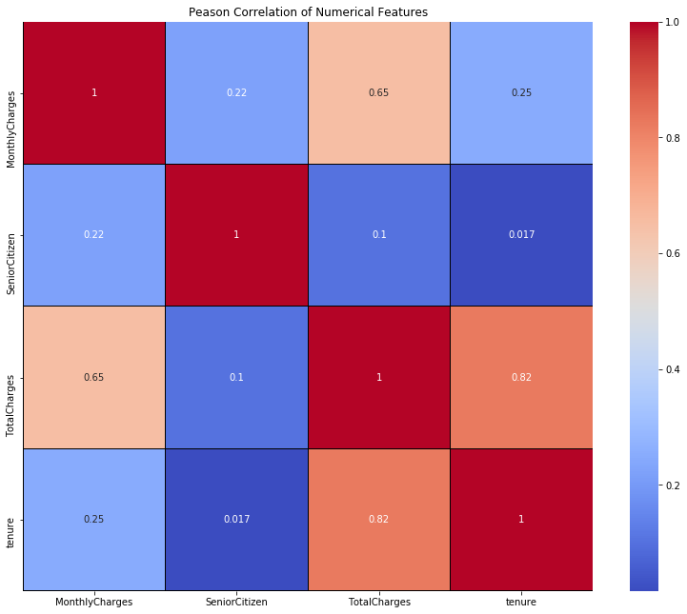
PEASON CORRELATION

Slide 6
CREATING DUMMIES
NEED TO BE ABLE TO ANALYZE CATEGORICAL DATA
USED PANDAS TO CONVERT CATEGORICAL VALUES TO NUMBERS
ABLE TO SEE HOW MORE VARIABLE RELATE TO THE TARGET VARIABLE

Slide 7
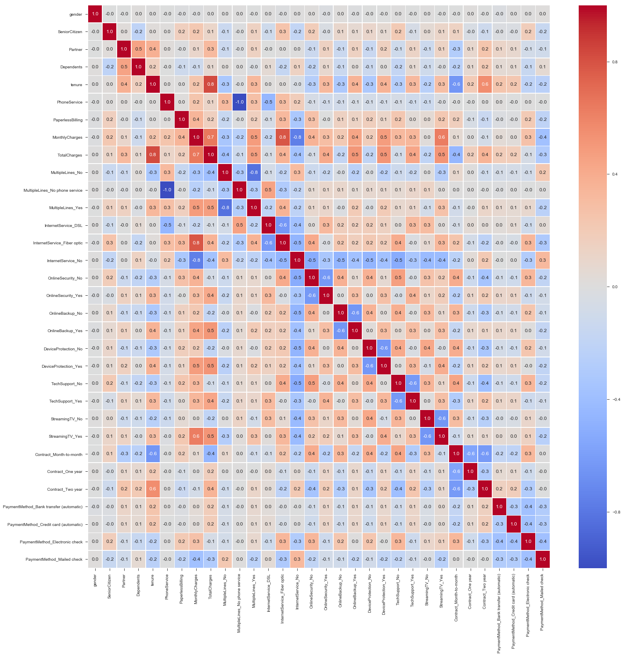

Slide 8
FEATURE IMPORTANCE
USING A SURPERVISED MODEL TO SELECT A FEATURE IMPORTANCE ALGORITHM
DECISION TREE CLASSIFIER

Slide 9
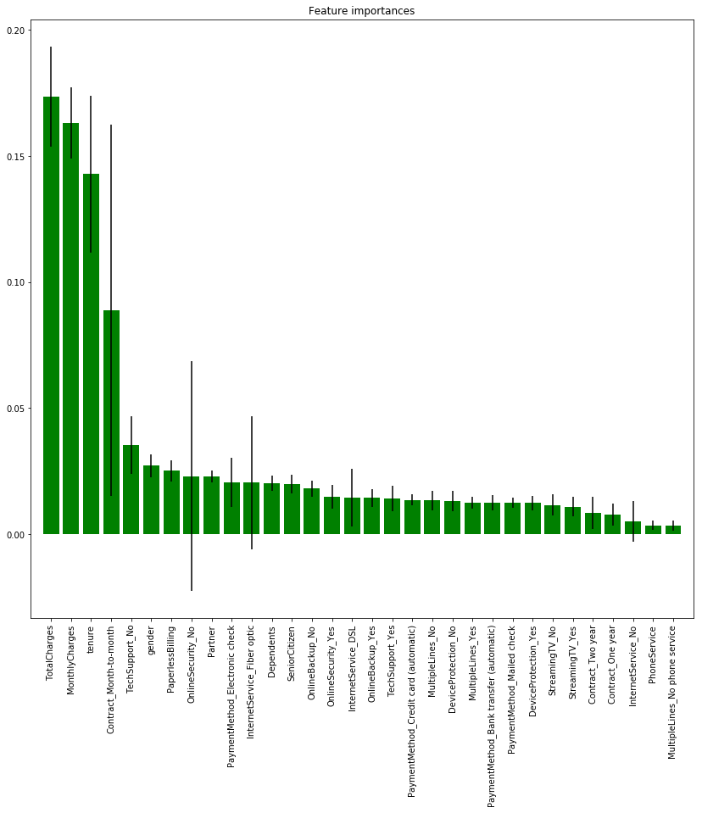

Slide 10
BUSINESS RECOMMENDATIONS
CUSTOMERS WHO CANCEL THEIR SUBCRIPTION ARE USUALLY IN THE EARLY STAGES OF THEIR TENURE.
FOCUS MORE ON STATISFYING NEWER CUSTOMERS TO INCREASE THEIR TENURE

Slide 11
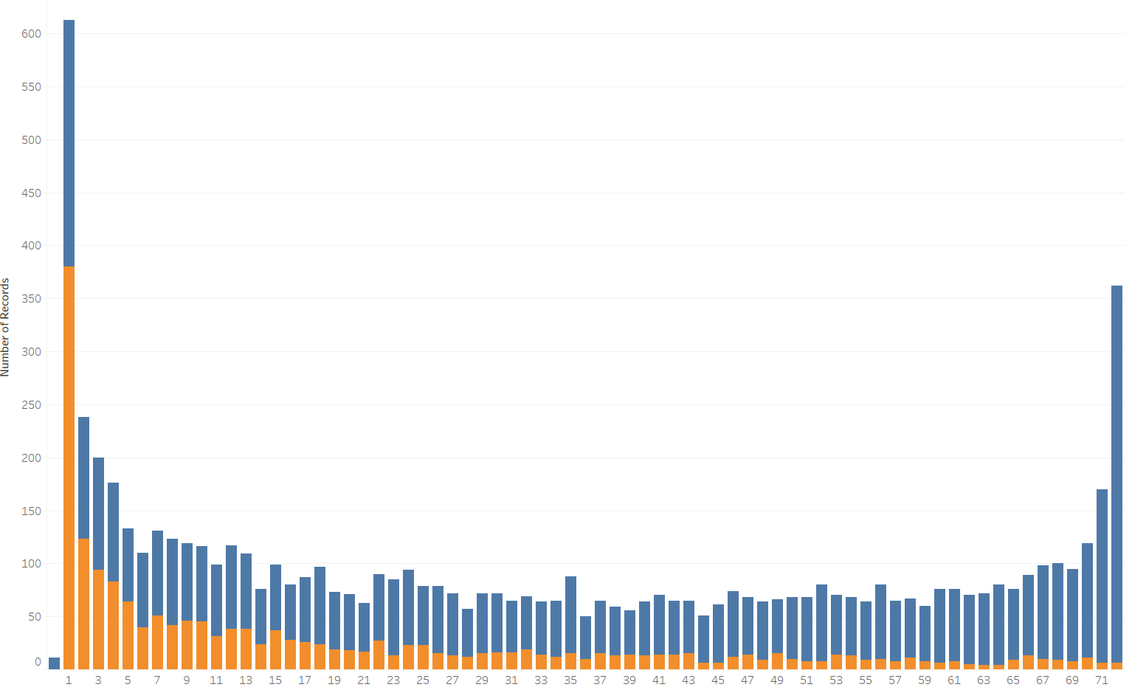

TENURE
TENURE

Slide 12
BUSINESS RECOMMENDATIONS
MONTH-TO-MONTH CONTRACT HOLDERS ARE MORE LIKELY TO END THEIR SUBCRIPTION COMPARED TO LONG-TERM CONTRACT HOLDERS
RECOMMENDATION, ALWAYS TRY TO GET CUSTOMER TO COMMIT WITH A LONG-TERM CONTRACT

Slide 13
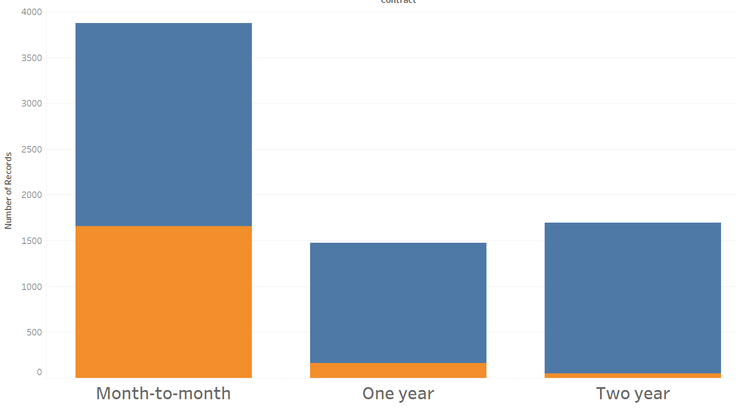
CONTRACTS

Slide 14
BUSINESS RECOMMENDATIONS
CUSTOMERS WITHOUT SERVICES SUCH AS TECH SUPPORT, ONLINE SECURITY, ONLINE BACK UP, ARE MORE LIKELY TO END THEIR SUBCRIPTION
RECOMMENDATION, ENTICING CUSTOMERS TO APPLY OR UTILIZE THESE SERVICES WILL DECREASE THEIR LIKELIHOOD OF ENDING THEIR SUBSCRIPTION

Slide 15
PREDICTIONS
ALGORITHMS TESTED:
SUPPORT VECTOR MACHINE
K NEIGHBORS CLASSIFIER
GUASSIAN NAÏVE BAYES
LOGISTIC REGRESSION
USED A CONFUSION MATRIX TO TEST OUT THEIR ACCURACY
LOGISTIC REGRESSION CAME UP WITH THE BEST SCORE

Slide 16
FUTURE WORK
BUILD A DECISION TREE
ADD MORE DATA TO TRAIN THE MODELS
IMPROVE ACCURACY SCORES
IMPROVE FEATURE IMPORTANCE ALGORITHM

Slide 17
THANK YOU

